Slide 1
GUI Applications with C♯
Rasmus Lystrøm
Associate Professor
ITU
rnie@itu.dk

Slide 2
Agenda
UI Frameworks for C♯
XAML
WPF
Xamarin.Forms
MVVM

Slide 3
UI Frameworks for C♯

Slide 4
UI Frameworks for C♯
Windows Forms (WinForms) (2002)
Windows Presentation Foundation (WPF) (2006)
Xamarin.Forms (2014) (acquired by Microsoft in 2016)
Universal Windows Platform (UWP) (2015)
WinUI (2021)
.NET Multi-platform App UI (MAUI) (2021)
Web (next week)
ASP.NET WebForms (2002)
ASP.NET MVC (2009)
ASP.NET Web Pages (2010)
Blazor (2018)

Slide 5
UI Frameworks
Demo

Slide 6
Frameworks compared
UWP / WinUI | Xamarin.Forms → MAUI | WPF/WinForms
Native Windows 10 | iOS | Windows 7+
HoloLens | Android
Surface Hub | Windows
Surface Pro X

Slide 7
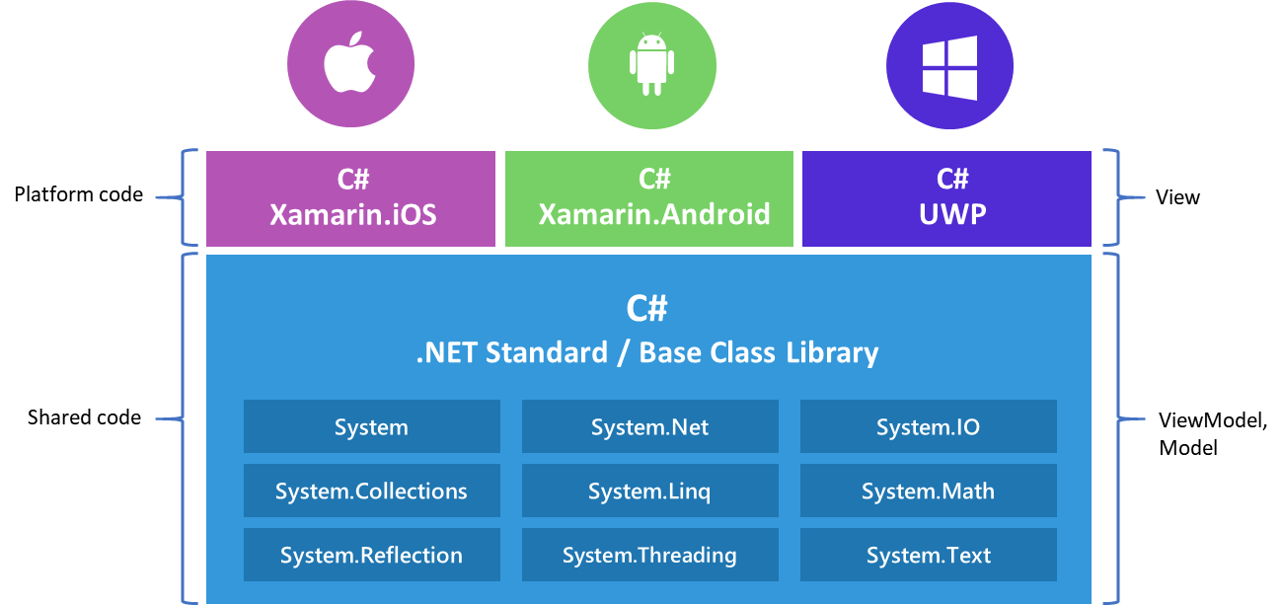
Xamarin Native vs Xamarin.Forms
Source: https://www.codemag.com/article/1911092

Slide 8
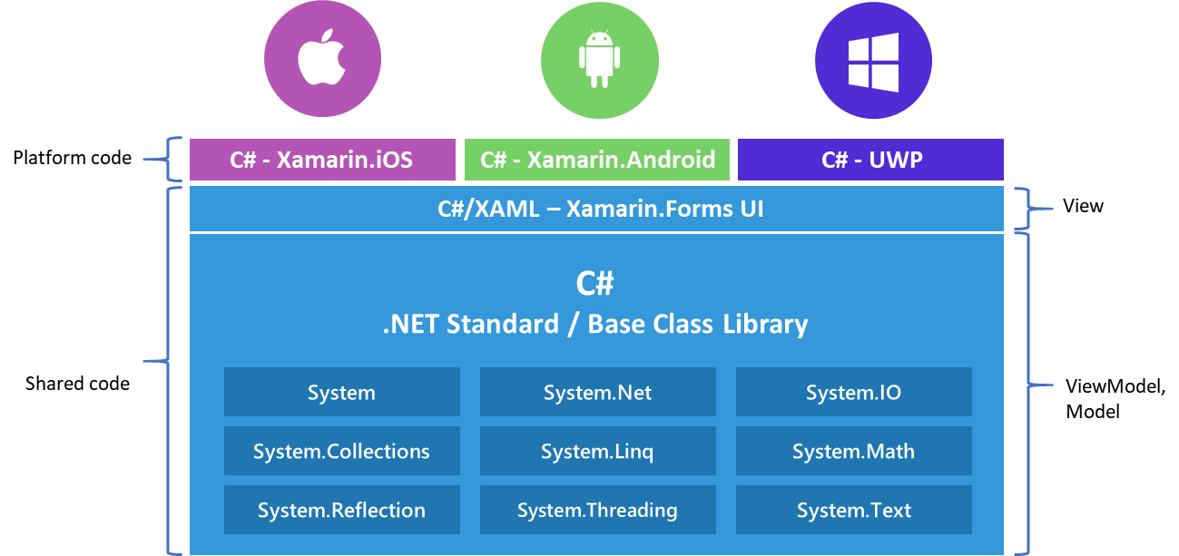
Xamarin Native vs Xamarin.Forms
Source: https://www.codemag.com/article/1911092

Slide 9
XAML

Slide 10

XAML = eXtensible Application Markup Language
Windows Desktop (WPF)
Universal Windows Platform (anything windowsy)
Xamarin.Forms (iOS, Android, Windows)
Silverlight (web)

Slide 11
XAML
Markup language for declaratively designing and creating application UIs
XAML maps XML markup to objects in the .NET Framework
Every tag maps to a class and every attribute to a property
Markup and procedural code are peers in functionality and performance
Code and markup are both first class citizens
Consistent model between UI, documents, and media
Compiled to code

Slide 12
XAML Markup vs. Code
<Button Width="100">OK
<Button.Background>
Purple
</Button.Background>
</Button>
OK
var button = new Button();
button.Content = "OK";
button.Background = new SolidColorBrush(Colors.Purple);
button.Width = 100;

Slide 13
MainPage.xaml
<Page>
<Grid>
<StackPanel>
<Ellipse Name="Light" Fill="Red"
Height="200" Width="200" Margin="50" />
<Button Width="150"
Content="Change Lights"
HorizontalAlignment="Center"
Click="Button_Click" />
</StackPanel>
</Grid>
</Page>

Slide 14
MainPage.xaml.cs
namespace App
{
public sealed partial class MainPage : Page
{
public MainPage()
{
this.InitializeComponent();
}
private void Button_Click(object sender, RoutedEventArgs e)
{
var current = Light.Fill as SolidColorBrush;
if (current.Color == Colors.Red)
Light.Fill = new SolidColorBrush(Colors.Green);
else
Light.Fill = new SolidColorBrush(Colors.Red);
}
}
}

Slide 15
WPF
Demo

Slide 16
XAML + Code Behind
<StackPanel>
<Ellipse Name="Light" Fill="Red" Height="200" Width="200"
Margin="50" />
<Button Width="150" Content="Change Lights"
HorizontalAlignment="Center" Click="Button_Click" />
</StackPanel>
private void Button_Click(object sender, RoutedEventArgs e)
{
var current = Light.Fill as SolidColorBrush;
if (current.Color == Colors.Red)
{
Light.Fill = new SolidColorBrush(Colors.Green);
}
else
{
Light.Fill = new SolidColorBrush(Colors.Red);
}
}
Image source: http://lazergaze.tumblr.com/post/26333564955

Slide 17
MVVM

Slide 18
The Model-View-ViewModel Pattern
Separation of logic and presentation
Having event handlers in the code-behind is bad for testing, since you cannot mock away the view
Changing the design of the view often also requires changes in the code, since every element has its different event handlers
The logic is tightly bound to the view. It's not possible to reuse the logic in an other view

Slide 19
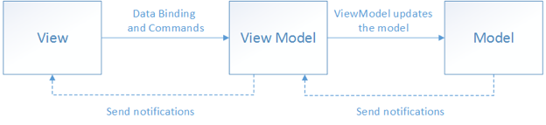
MVVM

Slide 20
MVVM
Demo

Slide 21
MVVM concepts
There is conceptually only ever one MODEL
Code in code-behind should be ABSOLUTELY MINIMAL
A ViewModel should ALWAYS implement INotifyPropertyChanged
A ViewModel may be used for more than one view

Slide 22
MVVM Design Patterns
Observer Pattern:
INotifyPropertyChanged
ObservableCollection<T>
Command Pattern:
ICommand

Slide 23

MVVM Tips
Don’t use frameworks:
MVVM Light
Template 10
Get your hands dirty first!
Image source: https://dirtyhands.wordpress.com

